Slide 1
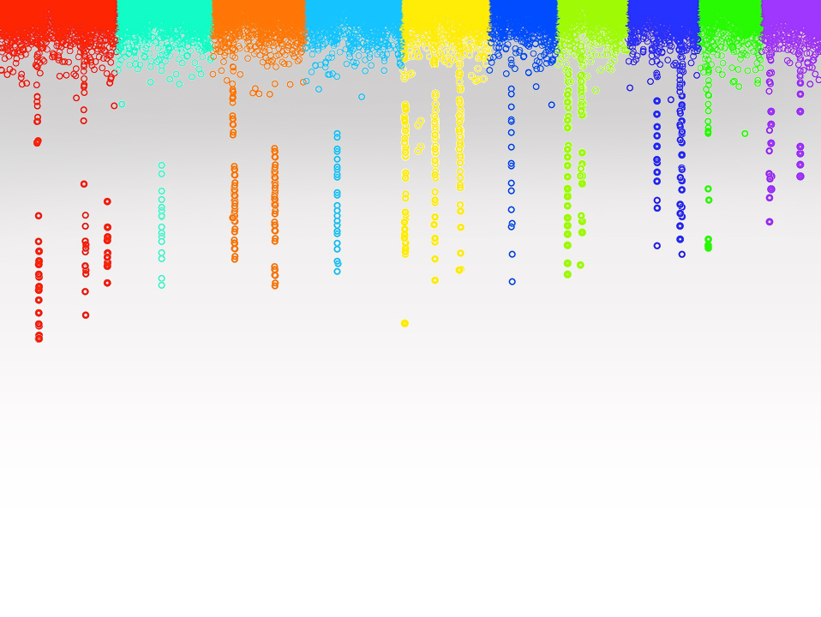

Statistical Genomics
Lecture 21: FarmCPU
Zhiwu Zhang
Washington State University

Slide 2
Administration
Homework 5, due April 13, Wednesday, 3:10PM
Final exam: May 3, 120 minutes (3:10-5:10PM), 50
Department seminar (April 4) , Nural Amin

Slide 3
Outline
History of method and software development
FarmCPU
BLINK

Slide 4

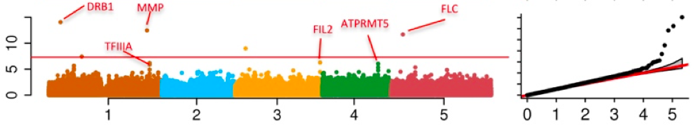
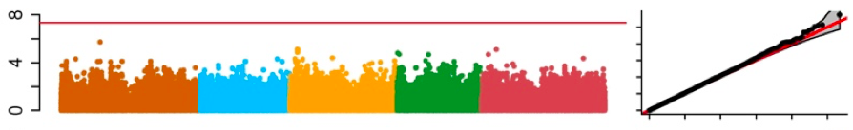
Problems in GWAS
Computing difficulties: millions of markers, individuals, and traits
False positives, ex: “Amgen scientists tried to replicate 53 high-profile cancer research findings, but could only replicate 6”, Nature, 2012, 483: 531
False negatives

Slide 5
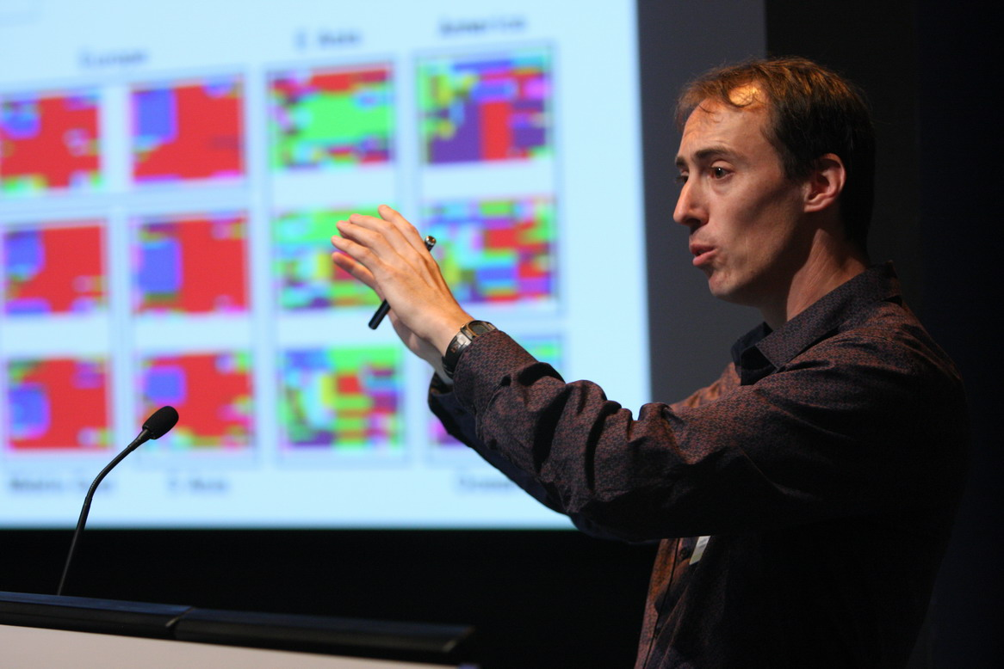

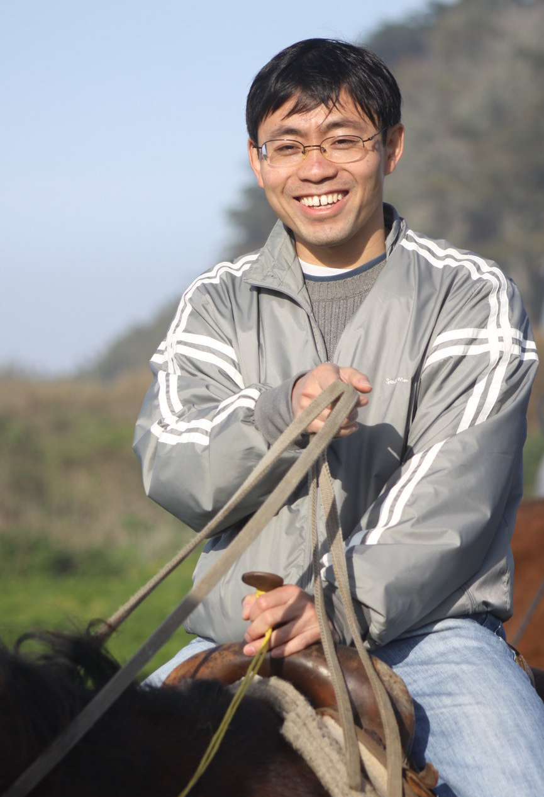

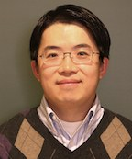
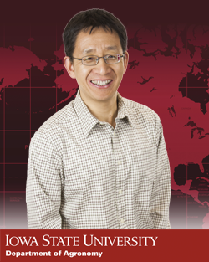
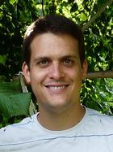

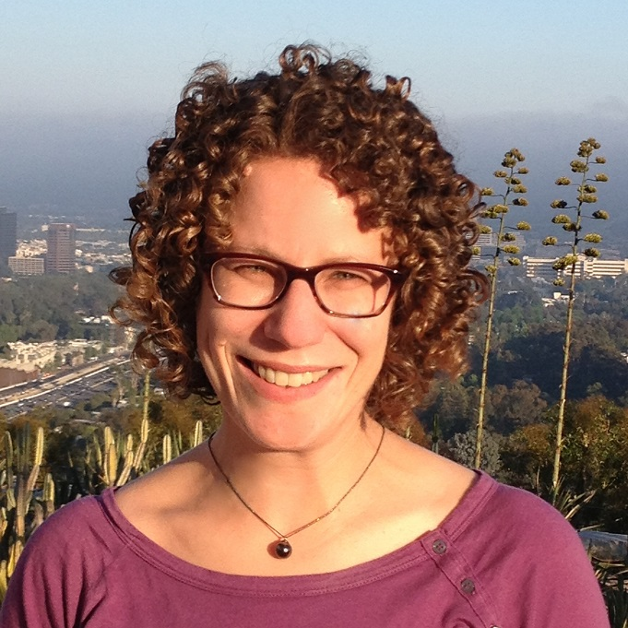
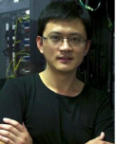
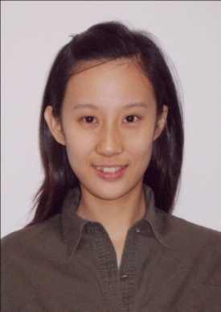
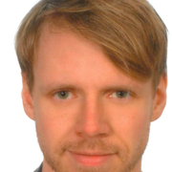
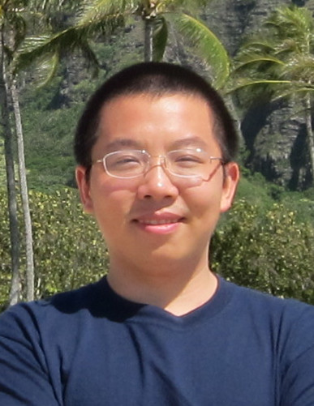


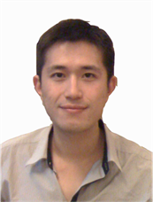
Q
EMMA
PC+K
PC
EMMAx
Q+K
GWAS Stream
MLMM
CMLM
P3D
SELECT
GCTA
ECMLM
FST-LMM
GEMMA
FarmCPU
GenAbel
BLINK

Slide 6
t test
Speed improvement
Power
improvement
GLM
GenABEL
Computing speed
FaST-LMM
CMLM
ECMLM
GEMMA
Select
P3D/EMMAX
SUPER
EMMA
MLMM
MLM
Power | type I error

Slide 7
Usage of Software Packages
Software | Leading Authors | Corresponding authors | Language | Released | Citation
PUMA | Gabriel E. Hoffman | Jason G. Mezey | C++ | 2013 | 8
TATES | Sophie van der Sluis | Sophie van der Sluis | Fortran | 2013 | 20
GAPIT | Lipka AE | Zhang Z | R | 2012 | 106
MLMM | Vincent S | Nordborg M | R/python | 2012 | 69
GEMMA | Zhou X | Stephens M | C++ | 2012 | 88
FastLMM | Christoph L, Listgarten J, Heckerman D | Christoph L, Listgarten J, Heckerman D | C++ | 2011 | 104
Qxpak | M. Pérez-Enciso | M. Pérez-Enciso | Fortran | 2004 | 141
EMMAX | Kang HM | Sabatti C & Eskin E | C++ | 2010 | 349
GCTA | Jian Y | Jian Y | C++ | 2011 | 380
GenABEL | Aulchenko YS | Aulchenko YS | R | 2007 | 510
TASSEL | Bradbury PJ, Zhang Z, Kroon DE | Bradbury PJ | Java | 2006 | 660
PLINK | Purcell S | Purcell S | C++ | 2007 | 7037
75%

Slide 8
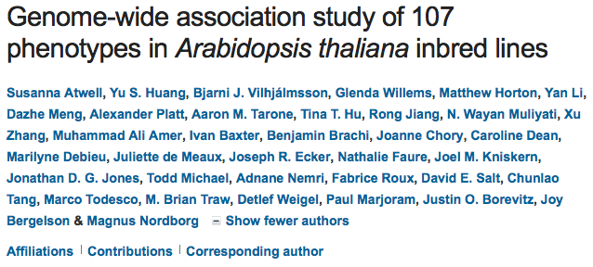
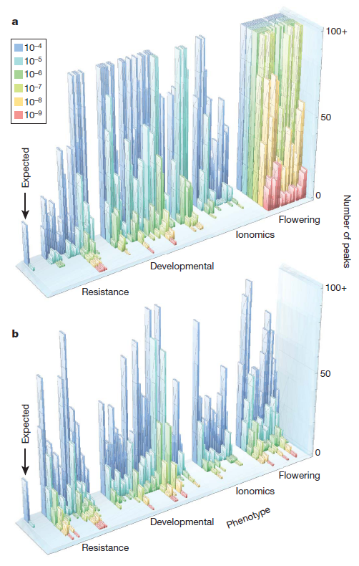

GWAS does not work for traits associated with structure
Test WO correction
Nature 2010
Correction with MLM
Magnus Norborg

Slide 9
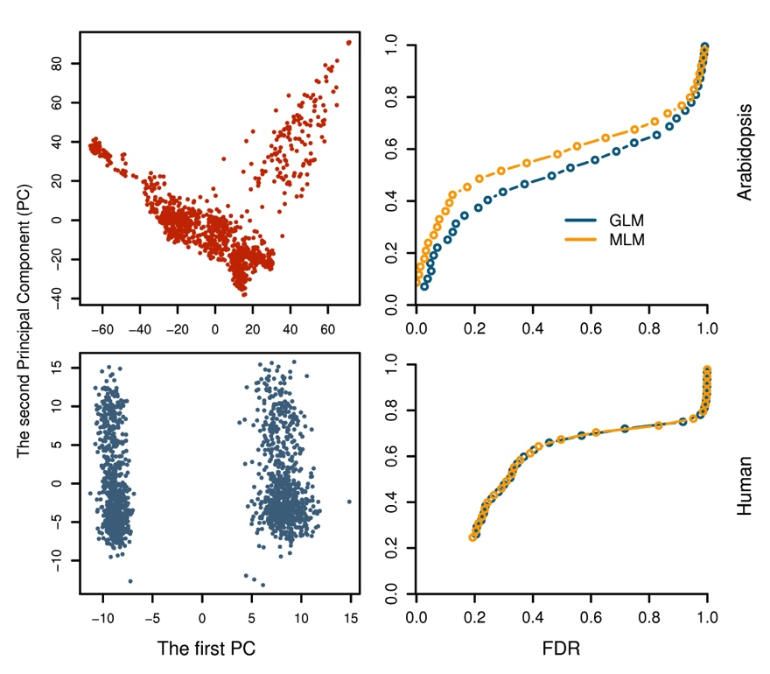
Why human geneticists not go beyond PLINK?

Slide 10
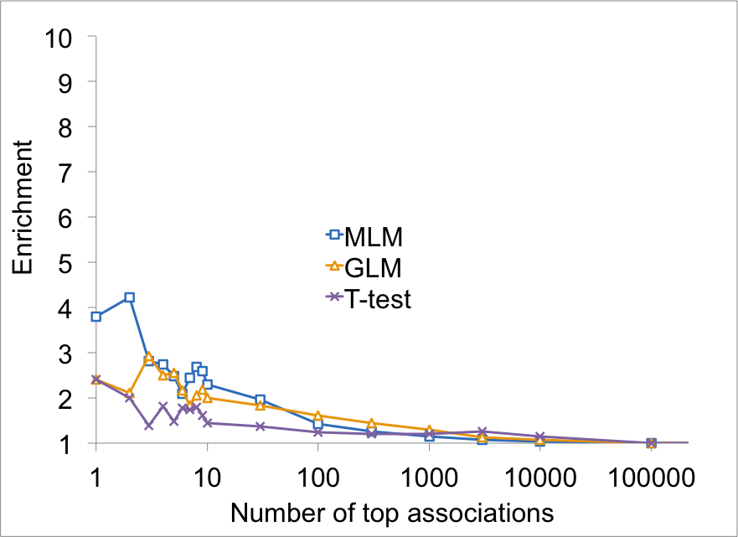
MLM was more enriched on Flowering time genes

Slide 11
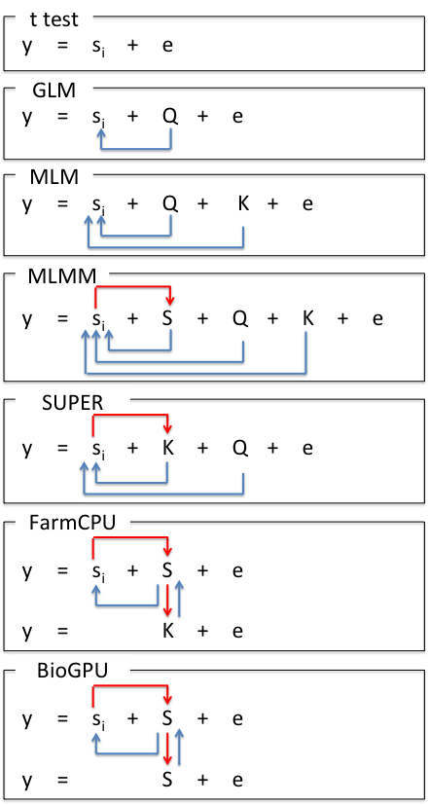
Model Development
S_{i}: Testing marker
Adjustment on marker
Q: Population structure
K: Kinship
Adjustment on covariates
S: Pseudo QTNs

Slide 12
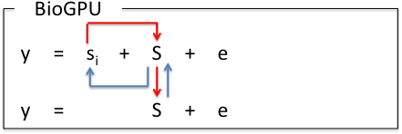
Model Development
S_{i}: Testing marker
Adjustment on marker
Q: Population structure
K: Kinship
Adjustment on covariates
S: Pseudo QTNs
BLINK

Slide 13
SUPER algorithm
y = PC + SNP + e
Bins
-2LL
QTNs
y = PC + Kinship + e
y = PC + Kinship + SNP + e

Slide 14
FarmCPU algorithm
y = PC + SNP + e
Bins
-2LL
QTNs
y = PC + Kinship + e
y = PC + QTNs + SNP + e

Slide 15
BLINK algorithm
y = PC + SNP + e
LD
BIC
QTNs
y = PC + QTNs + e
y = PC + QTNs + SNP + e

Slide 16
t test
Speed improvement
Power
improvement
GLM
GenABEL
BLINK
FarmCPU
Computing speed
FaST-LMM
CMLM
ECMLM
GEMMA
Select
P3D/EMMAX
SUPER
EMMA
MLMM
MLM
Power | type I error

Slide 17
GWAS methods
Known M
Random
model
fixed
model
M
m₁+…+m_{l}
m_{i}
m: marker
M: Mutation
K+ m_{i}
Q + m_{i}
M + m_{i}
Fixed And Random Model
Circulating Probability Unification
(FARM-CPU)
Notes:
Statistical models to detect mutations (M) underlying phenotype.
The items inside the circle are the operands and the the items outside the circle describe the best condition for each model. The ideal and unrealistic model (M) is to fit the mutations only. One if the realistic model (mm) fits all available markers (m_{i} to m_{l}) simultaneously. The model is computation demanding with more markers than mutations (m>M). The model (m) that fit one marker at a time has the least computation demand, but generate spurious association. The model (Qm) that fit population structure (Q matrix) as covariates reduce spurious associations without heavy penalty on computing time. The model (QKm) that adds additional random effect with variance defined by kinship (K), further reduces spurious association, but substantially increases computing time. Both Qm and QKm model have the problem of confounding between testing marker and other operand in the model, especially when markers are exactly the mutation (m=M). The confounding is diluted with genomic average Q and K with more markers (m>M). The model (Mm) that fits mutation (M) and marker (m) one at a time, has advantage on computing time and the potential of eliminating the confounding with testing markers. The challenge is too find M and the elimination of confounding, which will be illustrated in next figure (Bio-CPU).

Slide 18
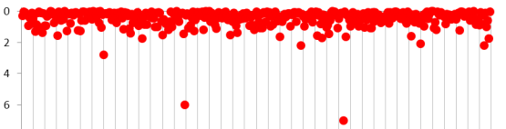
FARM-CPU (Fixed And Random Model Circuitous Probability Unification)
Fixed model
y = M₁ + … + M_{t} + m_{i} + e
SNP | p₁ | … | NA | … | NA | … | p_{l}
M_{t} | P_{t1} | … | P_{tj} | … | P_{tk} | … | P_{tl} | P_{t}
… | … | … | … | … | … | … | … | …
M₂ | P₂₁ | … | P_{2j} | … | P_{2k} | … | P_{2l} | P₂
M₁ | P₁₁ | … | P_{1j} | … | P_{1k} | … | P_{1l} | P₁
 | m₁ | … | m_{j} | … | m_{k} | … | m_{l}
Substitution
Random model
y = u + e with
Var(u)∝SVD(M)
Optimization
Notes:
FARM-CPU (Fixed And Random Model Circulative Probability Unification)
Keywords: substitution, test, screen, storage, memory, mutation, markers, formula, optimization, processer, unit, background,
The shaded area is the storage of p values for markers (dark shaded) and mutations (shadow shaded). The Manhattan plot (with red dots) area is the processer to optimize bin size and the bin selected as pseudo mutations (M) connected by the green wires. The equation is the processer to test marker (m) one at a time with mutation (M) as covariates. The p values of M are processed xx unit (non-shaded area) to get average P values which are connect by the blue wires to substitute the Nas for the corresponding markers which do not have P values in the test as they are confounded to M.

Slide 19
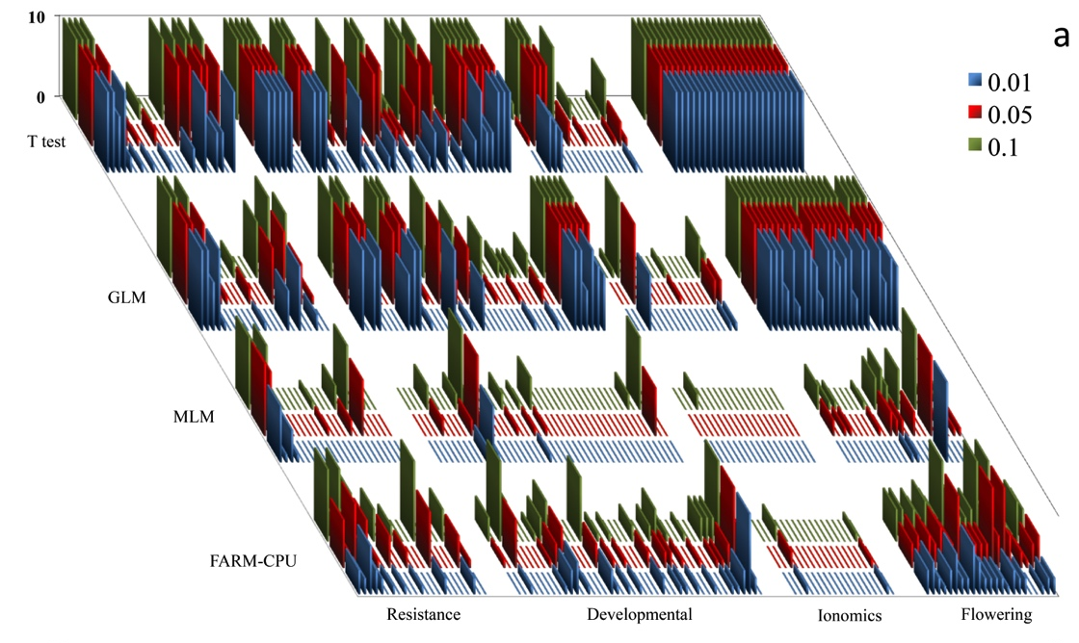
Re-analysis of Arabidopsis data
Xiaolei Liu

Slide 20
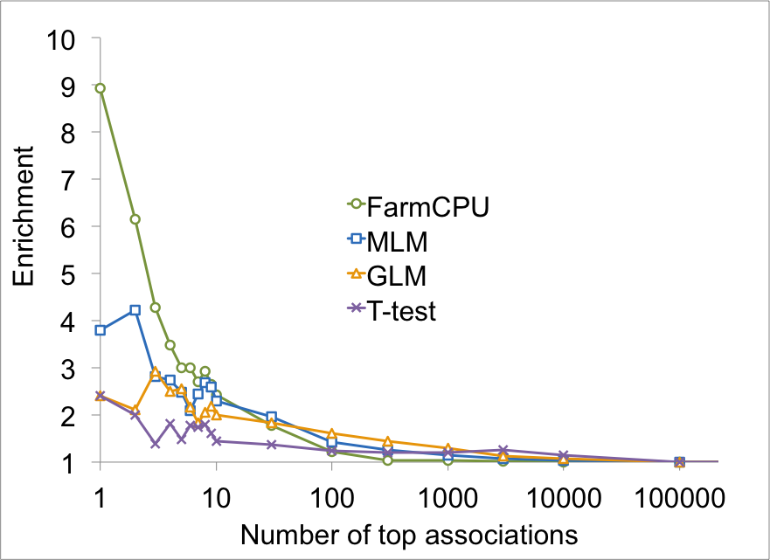
Flowering time genes enriched

Slide 21
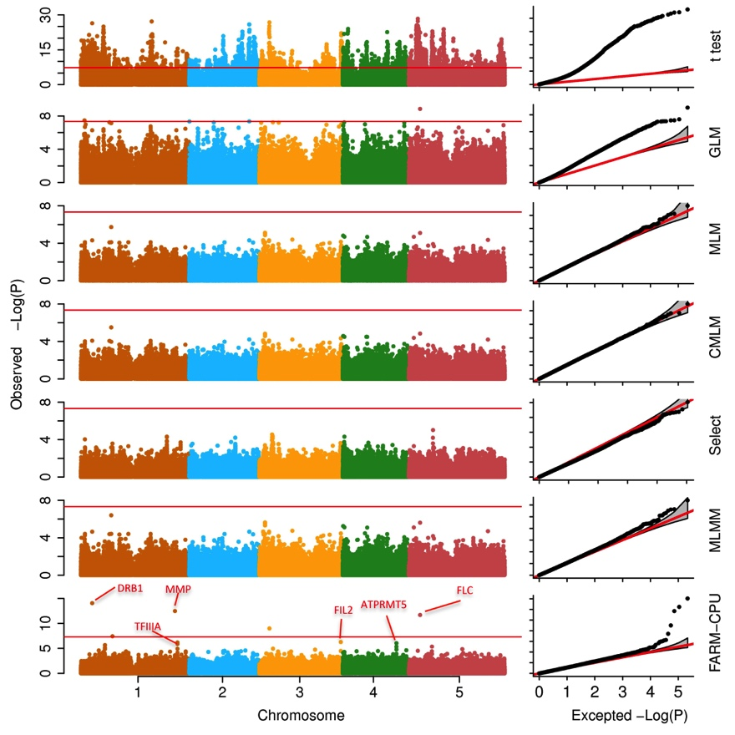
Associations on flowering time

Slide 22
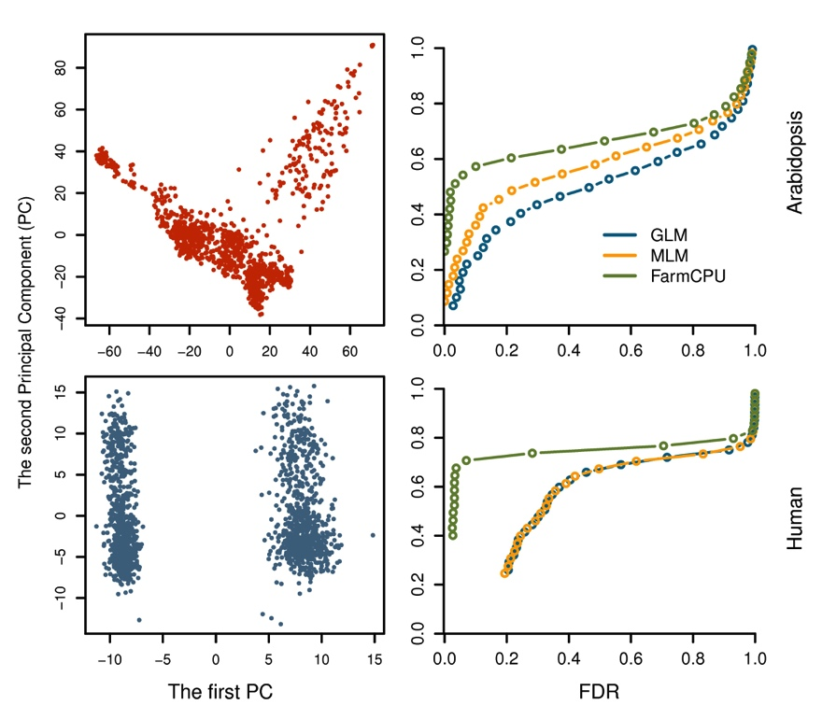
It is time for human geneticists to move forward

Slide 23
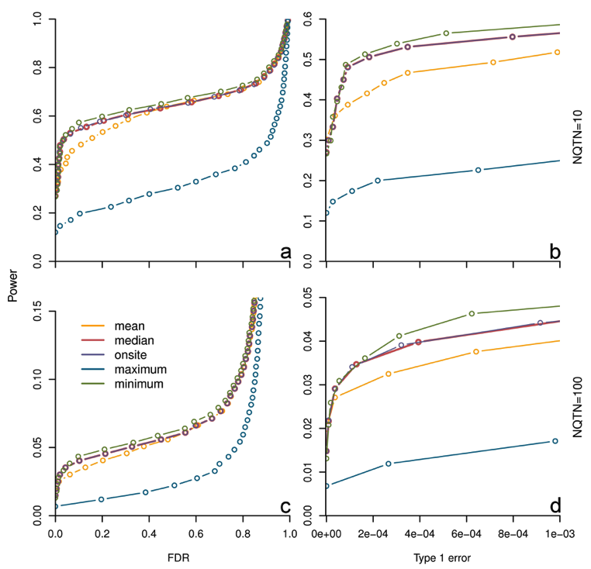
Substitution makes difference

Slide 24
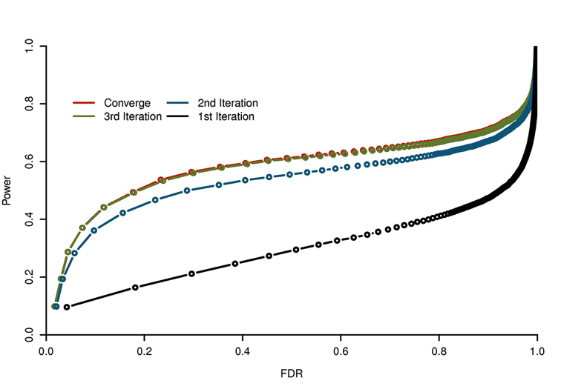
Converge fast

Slide 25
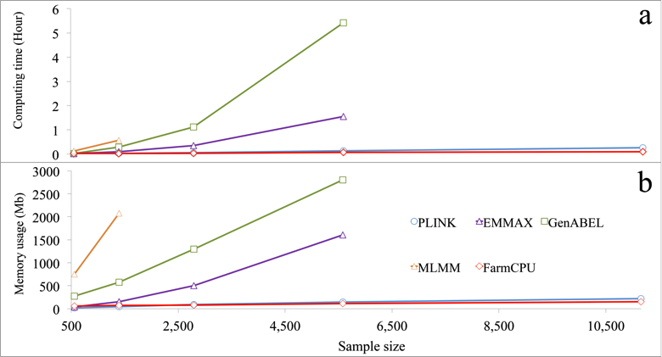
FarmCPU is computing efficient
Testing 60K SNPs

Slide 26
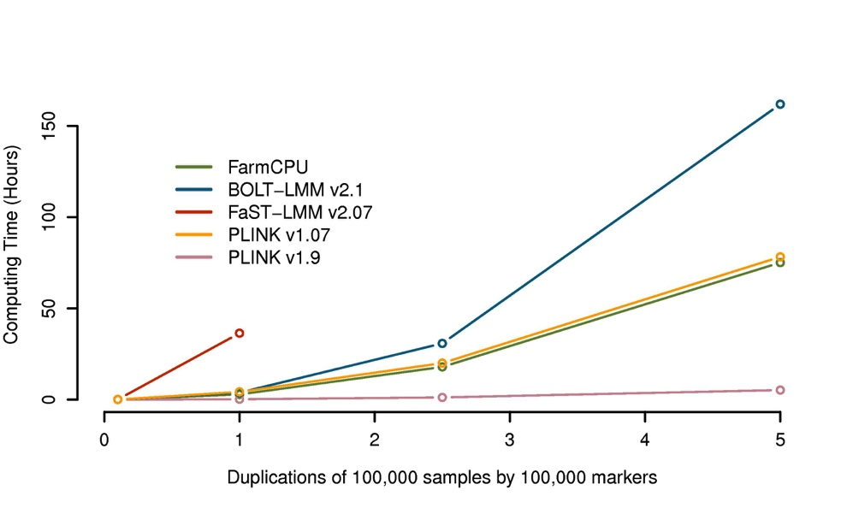
Half million individuals, half million SNPs three days
But, PINK new version is faster

Slide 27
BLINK

Slide 28
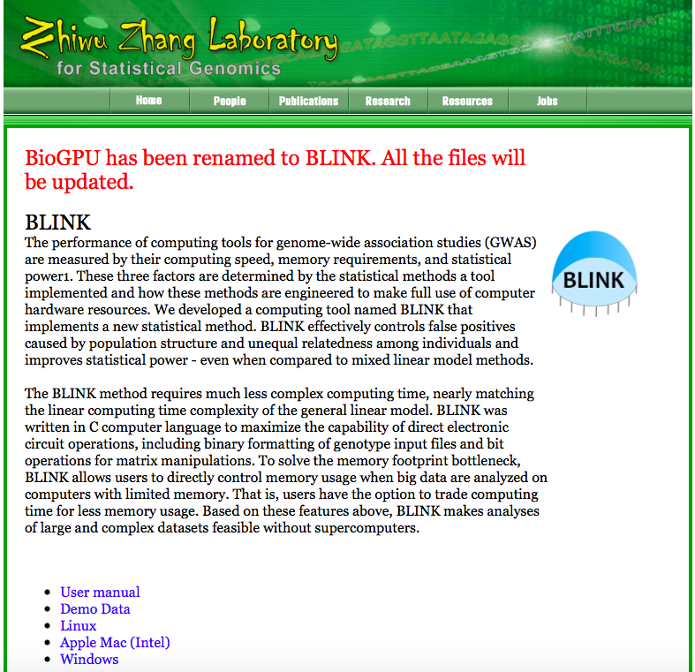
ZZLab.Net

Slide 29
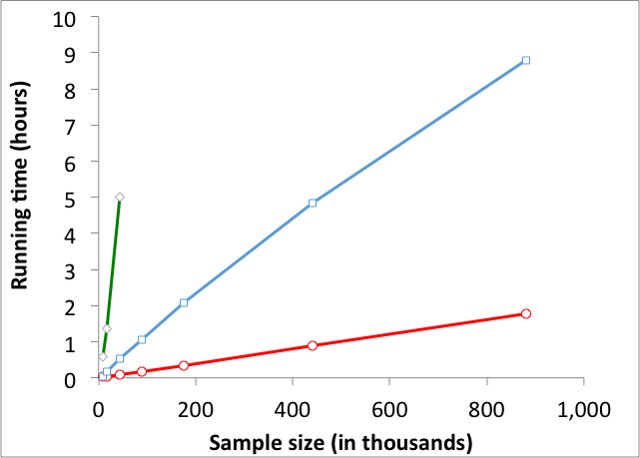
BLINK is super fast
Testing half million SNPs
PLINK
FarmCPU
BLINK
BLINK is 5X > PLINK, 200X > FarmCPU

Slide 30
Missing
(bin too small)
Missing
(bin too big)
LD
clustered

Slide 31
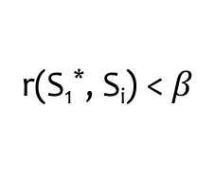
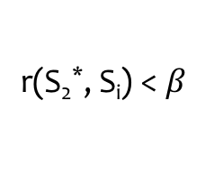
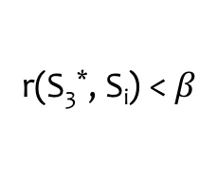
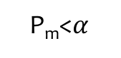
Remove SNPs in LD
y = s_{i} + S₁* + S₂ * + S₃ * + … + S_{k} * + e, where i = 1 to M
S₁*
S₂
… |  | S₂*
… |  | … |  | S₃*
… |  | … |  | … |  | S_{t}*
… |  | …
S_{m}
…
S_{M}
r(S₁*, S_{i}) <$β$
r(S₂*, S_{i}) <$β$
r(S₃*, S_{i}) <$β$
P_{m}<$α$

Slide 32
Bayesian information criterion
BIC=-2LL+k Ln(n)
k
t

Slide 33
y = s_{i} + S₁* + S₂ * + S₃ * + … + S_{k} * + e, where i = 1 to M
BIC
1
k
t
y = S₁* + S₂ * + S₃ * + … + S_{k} * + e, where k maximizes BIC

Slide 34
http://zzlab.net/GAPIT/data/Workshop_Iowa.R
BLINK
FarmCPU
GAPIT
PLINK

Slide 35
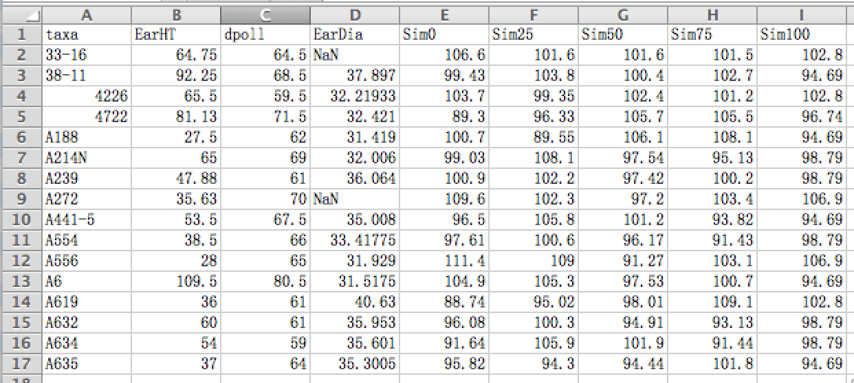
Format of phenotype data

Slide 36
Formats of genotype data
numeric
vcf
BLINK
PLINK
hapmap

Slide 37
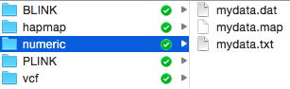
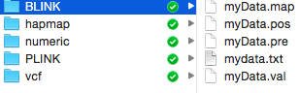
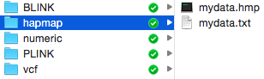
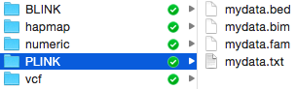
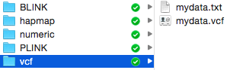
Format and file name extention

Slide 38
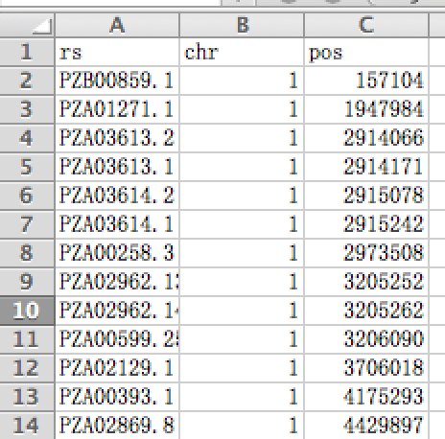
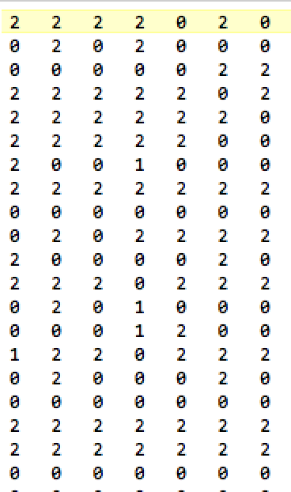
Numeric format
Individuals
SNPs
Genotype map
Genotype data

Slide 39
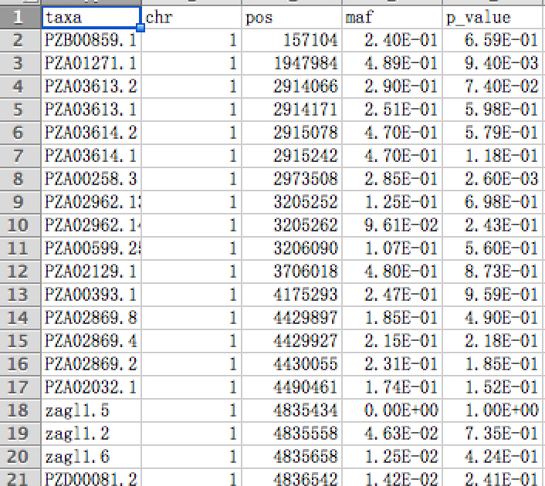
Output

Slide 40
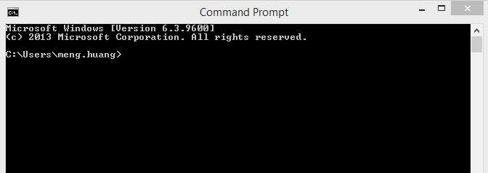
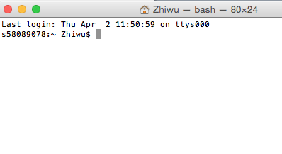
Run BLINK from command line
cd pathway
blink - -file myData - -numeric - -gwas - -out myResult

Slide 41


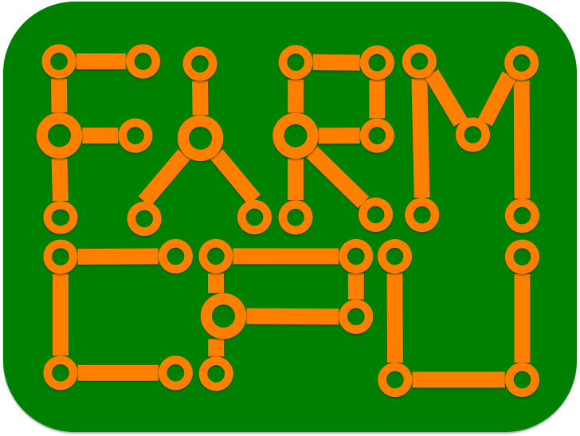


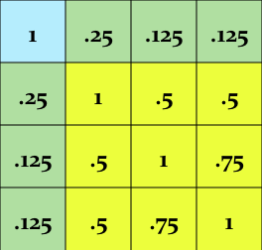
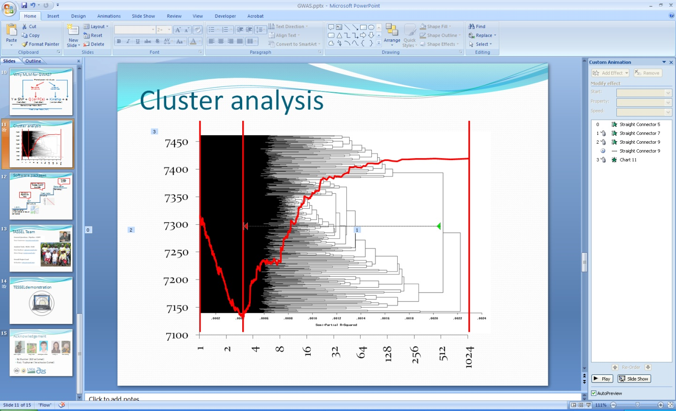
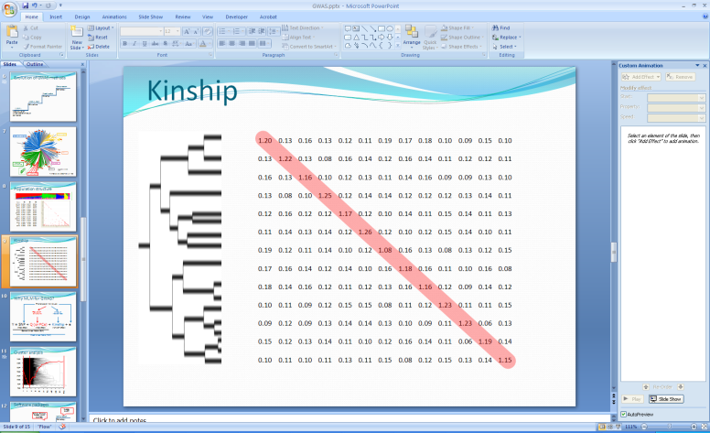

Ladder for high hanging fruits
GAPIT
TASSEL
GAPIT
ECMLM
EMMA, EMMAx,
GCAT, GenABEL
CMLM
Structure, Eigenstrate
PLIK
MLM
GLM
t, F, X²…
Uncorrelated or
equally correlated

Slide 42

Demonstration

Slide 43
Import GAPIT
rm(list=ls())
#Import GAPIT
#source("http://www.bioconductor.org/biocLite.R")
#biocLite("multtest")
#install.packages("gplots")
#install.packages("scatterplot3d")#The downloaded link at: http://cran.r-project.org/package=scatterplot3d
rm(list=ls())
library('MASS') # required for ginv
library(multtest)
library(gplots)
library(compiler) #required for cmpfun
library("scatterplot3d")
source("http://www.zzlab.net/GAPIT/emma.txt")
source("http://www.zzlab.net/GAPIT/gapit_functions.txt")
#source("~/Dropbox/GAPIT/Functions/emma.txt")
#source("~/Dropbox/GAPIT/Functions/gapit_functions.txt")

Slide 44
Import data and simulation
#Import demo data
myGD=read.table(file="http://zzlab.net/GAPIT/data/mdp_numeric.txt",head=T)
myGM=read.table(file="http://zzlab.net/GAPIT/data/mdp_SNP_information.txt",head=T)
#myGD=read.table(file="~/Dropbox/Current/ZZLab/WSUCourse/CROPS545/Demo/mdp_numeric.txt",head=T)
#myGM=read.table(file="~/Dropbox/Current/ZZLab/WSUCourse/CROPS545/Demo/mdp_SNP_information.txt",head=T)
#Simultate 10 QTN on the first half chromosomes
X=myGD[,-1]
index1to5=myGM[,2]<6
X1to5 = X[,index1to5]
taxa=myGD[,1]
set.seed(99164)
GD.candidate=cbind(taxa,X1to5)
mySim=GAPIT.Phenotype.Simulation(GD=GD.candidate,GM=myGM[index1to5,],h2=.5,NQTN=10, effectunit =.95,QTNDist="normal")
hist(mySim$effect)

Slide 45
ttest
#GWAS by GAPIT
setwd("~/Desktop/temp")
myGAPIT=GAPIT(
Y=mySim$Y,
GD=myGD,
GM=myGM,
QTN.position=mySim$QTN.position,
PCA.total=0,
group.from = 1,
group.to = 1,
group.by = 10,
#sangwich.top="MLM", #options are GLM,MLM,CMLM, FaST and SUPER
#sangwich.bottom="SUPER", #options are GLM,MLM,CMLM, FaST and SUPER
memo="ttest")

Slide 46
GLM
#GWAS by GAPIT
setwd("~/Desktop/temp")
myGAPIT=GAPIT(
Y=mySim$Y,
GD=myGD,
GM=myGM,
QTN.position=mySim$QTN.position,
PCA.total=3,
group.from = 1,
group.to = 1,
group.by = 10,
#sangwich.top="MLM", #options are GLM,MLM,CMLM, FaST and SUPER
#sangwich.bottom="SUPER", #options are GLM,MLM,CMLM, FaST and SUPER
memo="GLM")

Slide 47
MLM
#GWAS by GAPIT
setwd("~/Desktop/temp")
myGAPIT=GAPIT(
Y=mySim$Y,
GD=myGD,
GM=myGM,
QTN.position=mySim$QTN.position,
PCA.total=3,
group.from = 1000,
group.to = 1000,
group.by = 10,
#sangwich.top="MLM", #options are GLM,MLM,CMLM, FaST and SUPER
#sangwich.bottom="SUPER", #options are GLM,MLM,CMLM, FaST and SUPER
memo="MLM")

Slide 48
CMLM
#GWAS by GAPIT
setwd("~/Desktop/temp")
myGAPIT=GAPIT(
Y=mySim$Y,
GD=myGD,
GM=myGM,
QTN.position=mySim$QTN.position,
PCA.total=3,
group.from = 1,
group.to = 1000,
group.by = 10,
#sangwich.top="MLM", #options are GLM,MLM,CMLM, FaST and SUPER
#sangwich.bottom="SUPER", #options are GLM,MLM,CMLM, FaST and SUPER
memo="CMLM")

Slide 49
SUPER
#GWAS by GAPIT
setwd("~/Desktop/temp")
myGAPIT=GAPIT(
Y=mySim$Y,
GD=myGD,
GM=myGM,
QTN.position=mySim$QTN.position,
PCA.total=3,
group.from = 1,
group.to = 1000,
group.by = 10,
sangwich.top="MLM", #options are GLM,MLM,CMLM, FaST and SUPER
sangwich.bottom="SUPER", #options are GLM,MLM,CMLM, FaST and SUPER
memo="SUPER")

Slide 50
FarmCPU
#Compare FarmCPU#Installation of required R package (once for a computer, details see FarmCPU user manual.)
# install.packages("bigmemory")
# install.packages("biganalytics")
#Import library (each time to start R)
library(bigmemory)
library(biganalytics)
require(compiler) #for cmpfun
source("http://www.zzlab.net/FarmCPU/FarmCPU_functions.txt")#web source code
myFarmCPU= FarmCPU(
Y=mySim$Y,
GD=myGD,
GM=myGM )
myP=as.numeric(myFarmCPU$GWAS$P.value)
myGI.MP=cbind(myGM[,-1],myP)
GAPIT.Manhattan(GI.MP=myGI.MP,seqQTN=mySim$QTN.position)
GAPIT.QQ(myP)

Slide 51
BLINK
myY=mySim$Y
colnames(myY)=c("taxa", "SimPheno")
setwd("~/Desktop/temp")
myGD1=t(myGD[,-1])
write.table(myY,file="myData.txt",quote=F,row.name=F,col.name=T,sep="\t")
write.table(myGD1,file="myData.dat",quote=F,row.name=F,col.name=F,sep="\t")
write.table(myGM,file="myData.map",quote=F,row.name=F,col.name=T,sep="\t")
#run blink
system("~/Desktop/temp/blink --file myData --max_loop 10 --numeric --gwas")
#Extract p values
result<- read.table("SimPheno_GWAS_result.txt", head = TRUE)
myP=as.numeric(result[,5])
myGI.MP=cbind(myGM[,-1],myP)
GAPIT.Manhattan(GI.MP=myGI.MP,seqQTN=mySim$QTN.position)
GAPIT.QQ(myP)

